Slide 1

Jumping the Next Hurdles
An Analysis of the Philippines’
World Development Indicators
By: Santiago, Peter & Tuason, Jose Mari

Slide 2
1
Hurdle
The Past

Slide 3

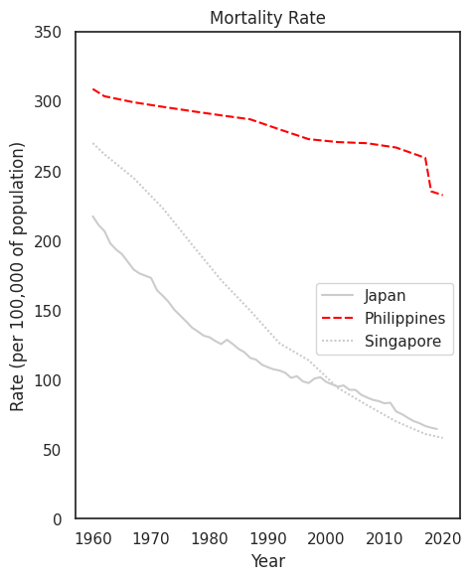
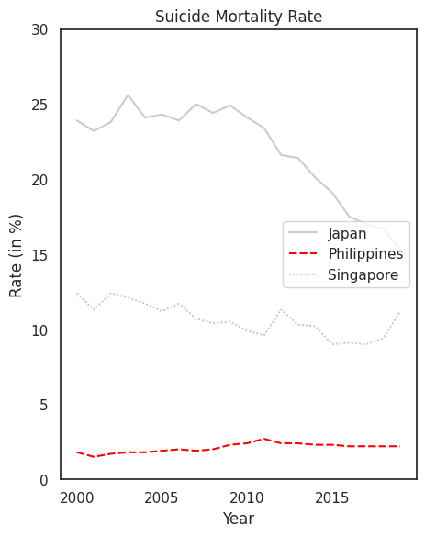
Life and Death in the Philippines
Mortality
Suicide
Despite the high mortality rate, Filipinos show resiliency with a low suicide rate

Slide 4
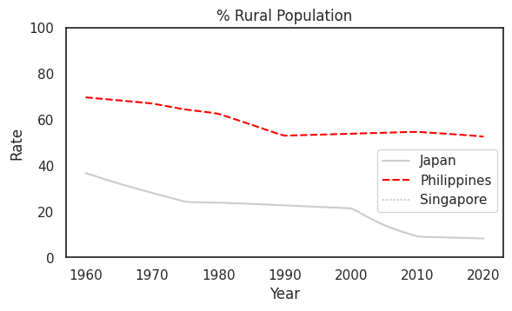
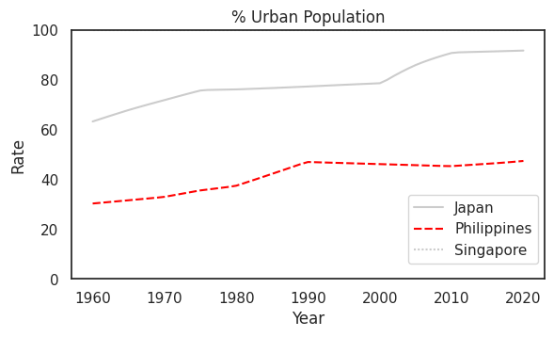
Population Growth
53%
47%
If we are to grow like Japan and Singapore (pure Urban – not visible in chart), we still need to push for urban development
Rural
Urban

Slide 5
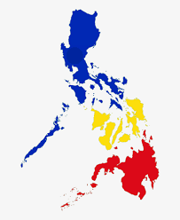
It’s more fun in the Philippines!
Philippines Number 1!
Coron
Boracay
292,549 tourists
2,034,599 tourists
Manila
Bohol
533,015 tourists
1,581,904 tourists
The “rural” vibe though works for us in terms of its appeal to tourists
Figures as of January-December 2019

Slide 6
2
The Present
Hurdle

Slide 7
Where We Are…
48%
48%
61%
50%
Safely Managed Drinking Water Services
Safely Managed Sanitation Services
Clean Fuels & Technologies for Cooking
Internet Services

Slide 8

Let there be light!
3%
Of the Filipino Population still does not have access to Electricity
?
75%
Japan and Singapore already at 100%
Electricity Access at the start of new decade
65%
1993
2020
1990
2000
97%
First reported Electricity Access for the Philippines
Philippines Current Access to Electricity

Slide 9
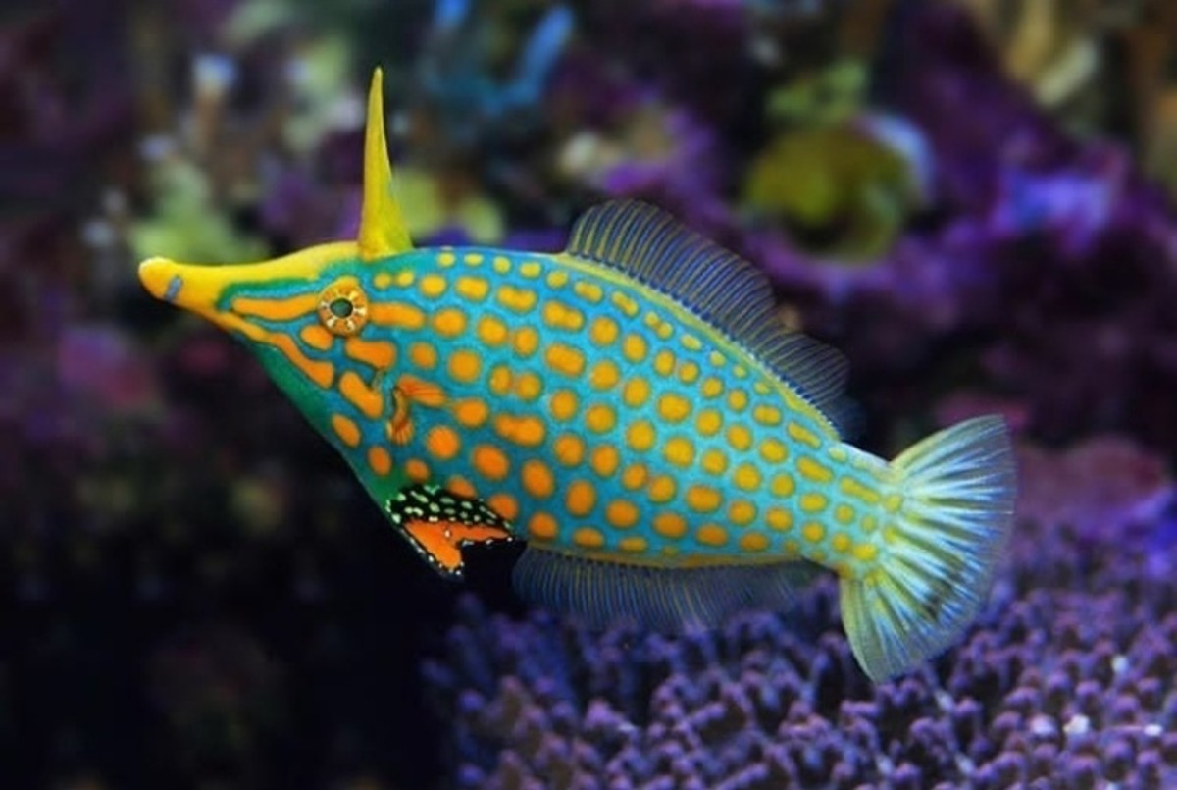



At a cost…
Species Threatened
As of 2018
93
91
Birds
Fish
38
Mammals
254
Plants

Slide 10

3,189!
Adjusted Net National Income per Capita (Current US$)

Slide 11
Net National Income In Comparison
Philippines
3,189
Japan
31,279
Myanmar
1,300
Vietnam
2,230
Laos
1,941
Singapore
42,126
Cambodia
1,320
Indonesia
3,079

Slide 12
3
Hurdle
The Future

Slide 13

Recommendations
Increase access to basic needs
01
Improve healthcare and continue support for mental health advocacies
02
Promote and support tourism initiatives
03
Ensure environmental considerations are in place for infrastructure projects
04
Invest! The Philippines is in a good spot to support development
05

Slide 14

Reminder
—Joseph E. Stiglitz, Nobel Economist
“Development is about transforming the lives of people,
not just transforming economies.”

Slide 15



Thanks!
Do you have any questions?
We don’t have answers! ☺

